Slide 1
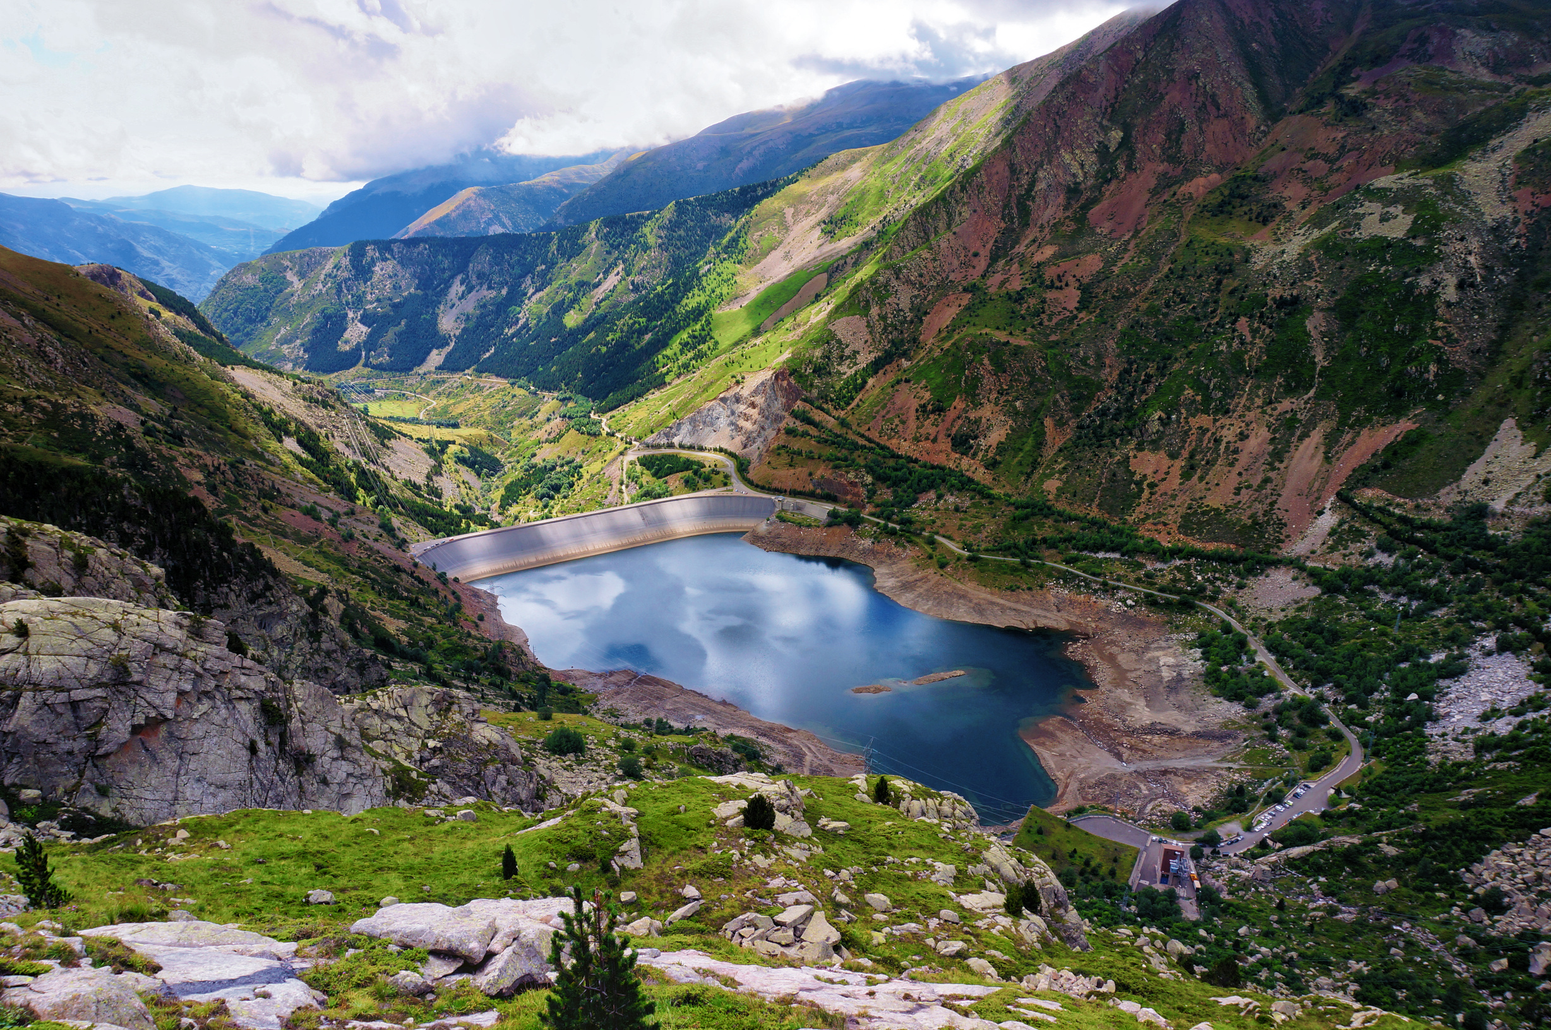

An Emotional Landscape of Euskara
SENTIMENT ANALYSIS OF THE BASQUE PARLIAMENT SPEECH CORPUS 1.0
presented by:
Claire McLean
University of Pittsburgh

Slide 2

“When Gen Francisco Franco banned the use of the ancient Euskara language, residents of the Basque Country fought to keep it alive.” (Bitong, 2022)
Introduction & Literature
Basque History
Why Sentiment Analysis?
Numerous attempts at eradication (Zuazo, 1996):
18th century
19th century
Franco dictatorship
Used by companies to determine how customers feel about a service or product
Usually positive, negative, or neutral
Basque Revitalization
Special Acknowledgement
After Franco’s death, revitalization efforts begun, including a reference grammar, a linguistic atlas, and proposals for lexicon modernization (Zuazo, 1996)
Govt. of Spanish Basque Country launched campaign (Bitong, 2022)
Language practice
Idea for Spanish Emotion Lexicon and inspiration for certain packages by (Griffen, 2023)
02
An Emotional Landscape of Euskara

Slide 3
Research Questions
Which sentiments in the SEL are expressed in the speech data?
What is the overall sentiment distribution across all of the parliament speech data? How does this compare with the distribution of the lexicon itself?
What are the most frequently used words for each sentiment expressed in the data?
03
An Emotional Landscape of Euskara

Slide 4
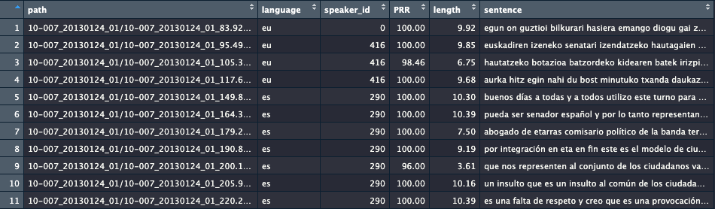
Basque Parliament Speech Corpus 1.0
04
Spanish Ministry of Science and Innovation (OPENSPEECH project)
Raw data in Basque (eu), Spanish (es), and bilingual (bi)
Plenary sessions (2013-2022)
1462 hours, 759,192 segments
Train dataset (largest)
An Emotional Landscape of Euskara

Slide 5
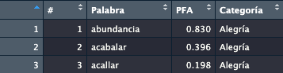
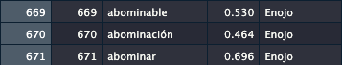
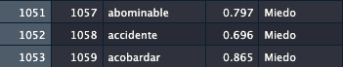
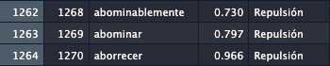
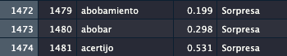
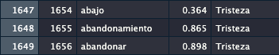
05
Spanish Emotion Lexicon
2,036 tokens/words
6 emotions: Alegría (Happiness, n=668), Enojo (Anger, n=382), Miedo (Fear, n=211), Repulsión (Disgust, n=209), Sorpresa (Surprise, n=175), Tristeza (Sadness, n=391)
Limitations:
Overlapping tokens
Some entire words
Some just semantically
An Emotional Landscape of Euskara

Slide 6
Data cleaning
06
Step 1: Removed irrelevant ‘Path’ column
Step 2: Filtered out bilingual and Basque-only utterances/rows
Step 3: Filtering relevant rows
str_detect()
Keywords: ['hablante', 'euskera', 'lenguaje', 'idioma', 'aprendizaje', 'lingüístic’]
Demonstrate relevance to language
Basic stats of cleaned data:
3,702 utterances/rows
6 variables/columns
Mean utterance length of 7.655
131 unique speakers
An Emotional Landscape of Euskara

Slide 7

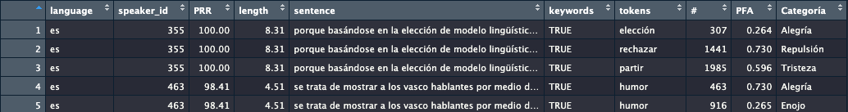
An Emotional Landscape of Euskara
Data pipeline
07
Step 1: Begin with *newly* cleaned data!
Step 2: Unnest sentence tokens (words) using unnest_tokens() function
Tokens already lowercase, but set to_lower=TRUE just in case
Step 3: Adjust column names to prepare for inner_join()
Step 4: Inner joined the two corpora by their matching tokens
Several arguments:
multiple = “all”
Some words have >1 emotion
unmatched = “drop”
Drop rows in speech corpus if there is no emotion word in common with SEL*
relationship = “many-to-many”
Sentence/utterance can have more than one emotion, and emotion can have more than one category...

Slide 8
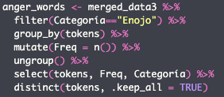
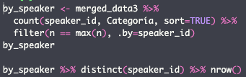
08
Data pipeline for analysis & visuals
Goals for analysis:
Goal 1: For each sentiment, identify represented words and find frequencies
Execution: create new dataframe for each emotion with all tokens, find freq per unique token
Visual: wordcloud, bar chart
Goal 2: Calculate general sentiment distribution overall. Compare with sentiment distribution in SEL alone
Visual: waffle
An Emotional Landscape of Euskara

Slide 9
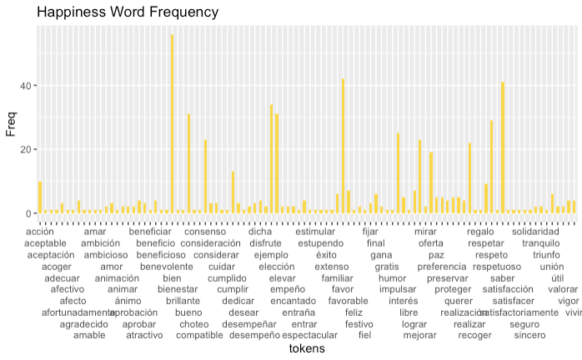
Alegría (Happiness, all data)
An Emotional Landscape of Euskara
09

Slide 10
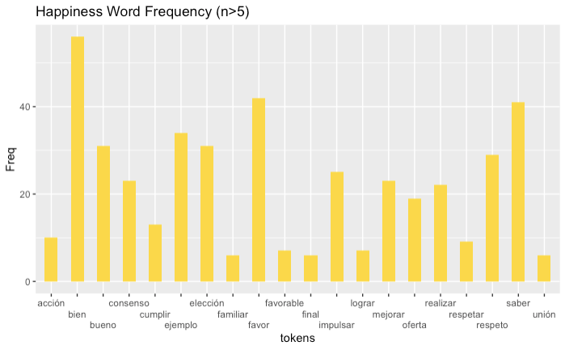
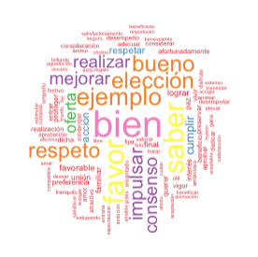
Alegría (Happiness, n>5)
Most frequent: ‘bien’ (good/well)
An Emotional Landscape of Euskara
10

Slide 11
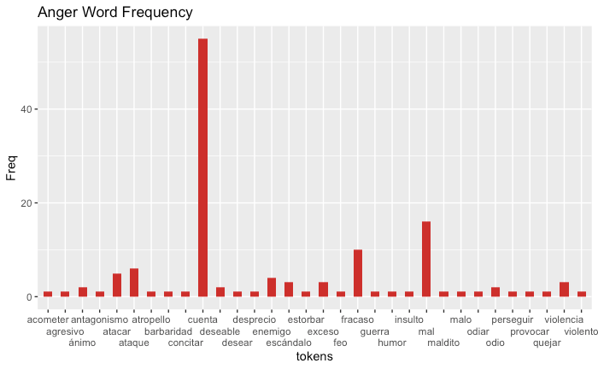
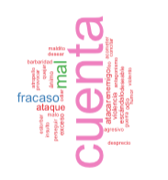
Enojo (Anger)
Most frequent: ‘cuenta’ (account)
An Emotional Landscape of Euskara
11

Slide 12
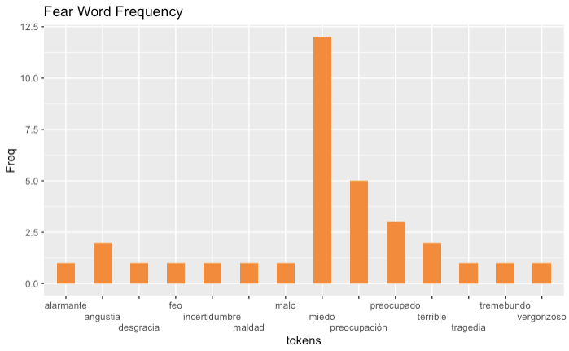
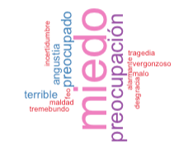
Miedo (Fear)
Most frequent: ‘miedo’ (fear)
An Emotional Landscape of Euskara
12

Slide 13
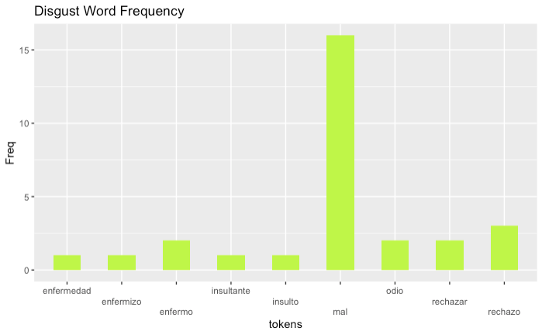
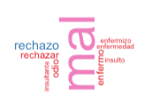
Repulsión (Disgust)
Most frequent: ‘mal’ (bad)
An Emotional Landscape of Euskara
13

Slide 14
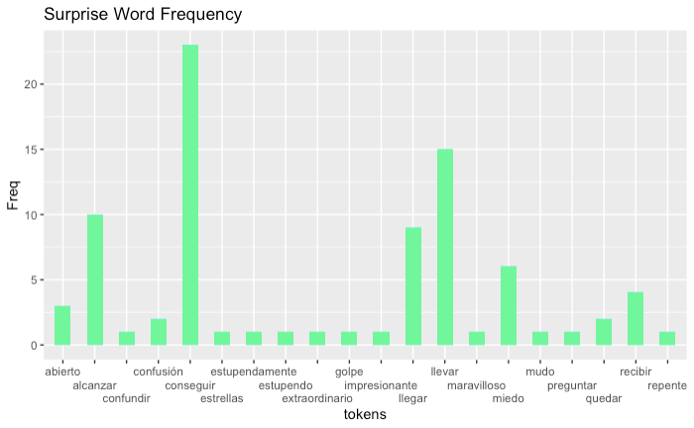
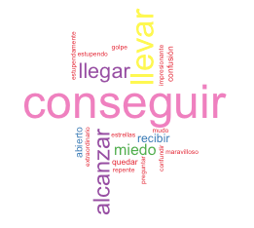
Sorpresa (Surprise)
Most frequent: ‘conseguir’ (to acquire/to achieve)
An Emotional Landscape of Euskara
14

Slide 15
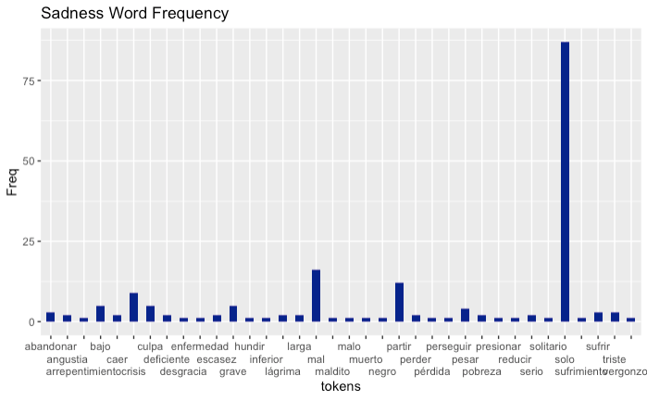
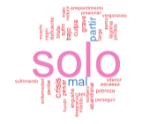
Tristeza (Sadness)
Most frequent: ‘solo’ (alone)
15
An Emotional Landscape of Euskara

Slide 16
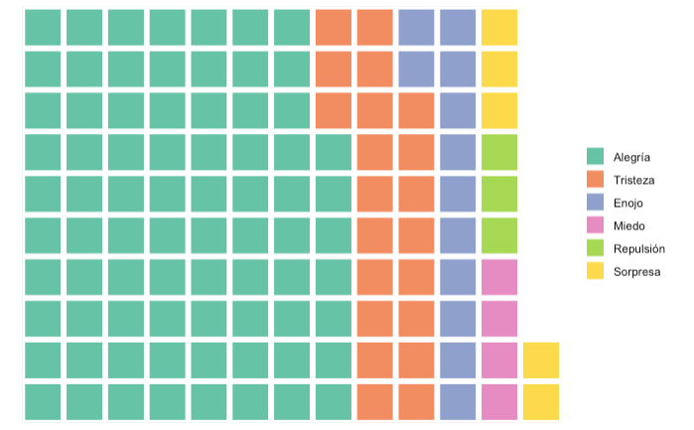
Sentiment Distribution Overall
16
Picture chart as a room in a parliament session...
Each square represents one parliament member who discussed language in a way that relates to a particular emotion (some members have more than one square, more than one emotion equally)
Are they actually happy when discussing language? Or is this a result of the emotion-related-words per emotion?
An Emotional Landscape of Euskara

Slide 17
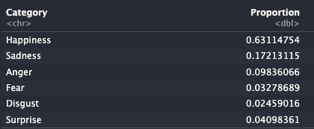
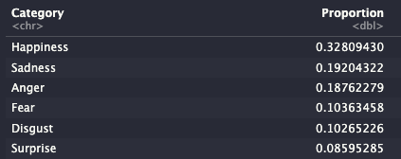
17
Comparing distributions
Are Basque parliament members generally happy when discussing language-related topics? Or is this an effect of a higher number of happiness-related tokens?
This distribution is not normal, but we can still ‘standardize’ the data...
Relative to their respective data frames, the proportion of speakers with each sentiment (usage set) differed compared to the proportion of words for each sentiment.
Happiness: larger in the usage set compared to the raw SEL word list.
Sadness: smaller in the usage set compared to the raw SEL word list.
Anger: smaller in the usage set compared to the raw SEL word list.
Fear: smaller in the usage set compared to the raw SEL word list.
Disgust: smaller in the usage set compared to the raw SEL word list.
Surprise: smaller in the usage set compared to the raw SEL word list.
Usage set
SEL raw word list
An Emotional Landscape of Euskara

Slide 18
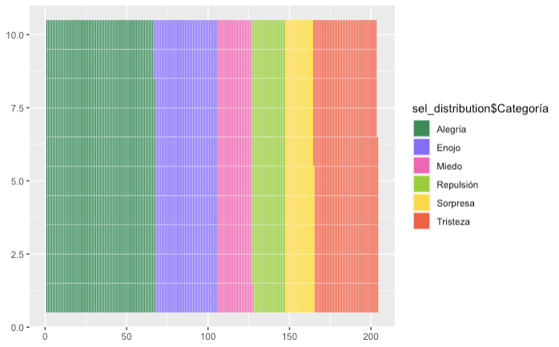
18
Comparing distributions
An Emotional Landscape of Euskara

Slide 19
19
Limitations
Token contexts were perhaps too general...
Difficult to isolate contexts
Do the keywords isolate Basque-only language discussion? Or more general language discussion?
Some tokens have multiple meanings...
‘solo’, ‘cuenta’, etc.
Some words are more ‘emotional’ than others...
‘tragedia’ vs. ‘solo’
Dropped rows in speech corpus if there is no emotion word in common with SEL*
Could have eliminated valuable data
An Emotional Landscape of Euskara

Slide 20
20
Future Implications
How can we harness emotion to revitalize language?
Granted that happiness appeared as the most frequently expressed emotion, how can we play on this emotion to inspire future revitalization efforts?
Which keywords are repeated the most? Could these words have an impact on future discussions about Basque?
Future research could introduce a model that more elaborately assesses sentiments toward language in Spanish-specific environments...
An Emotional Landscape of Euskara

Slide 21
References
The literature
Zuazo, K. (1996). The Basque Country and the Basque language. Towards a History of the Basque Language, 5. https://doi.org/10.1075/cilt.131.02zua
Bitong, A. (2022, February 24). The mysterious origins of europe’s oldest language. BBC. Retrieved December 5, 2024,.
The corpora
Grigori Sidorov, Sabino Miranda-Jiménez, Francisco Viveros-Jiménez, Alexander Gelbukh, Noé Castro-Sánchez, Francisco Velásquez, Ismael Díaz-Rangel, Sergio Suárez-Guerra, Alejandro Treviño, and Juan Gordon. Empirical Study of Opinion Mining in Spanish Tweets. LNAI 7629, 2012, pp. 1-14.
@misc {software_technologies_working_group_2024,
author = { {Software Technologies Working Group} },
title = { basque_parliament_1 (Revision a2fbcaf) },
year = 2024,
url = { https://huggingface.co/datasets/gttsehu/basque_parliament_1 },
doi = { 10.57967/hf/2485 },
publisher = { Hugging Face }
}
Technical
Griffen, K. (2023, March 27). Intro to Natural Langauge Processing. RPubs. https://rpubs.com/klgriffen96/data607_hw10
21

